Slide 1

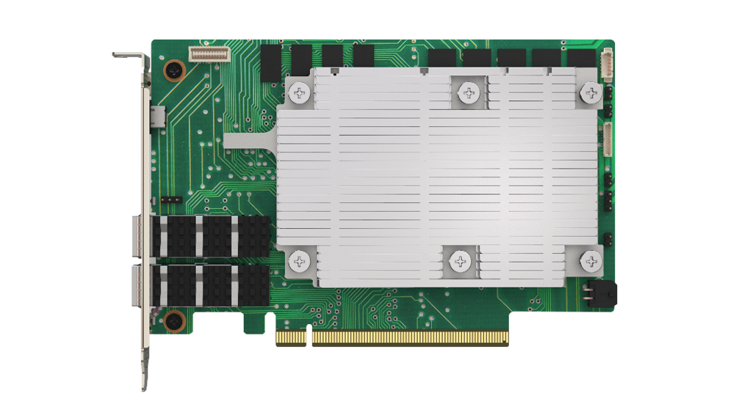
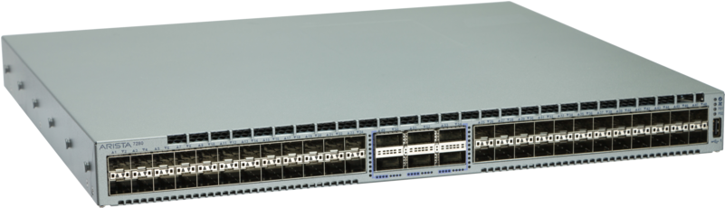
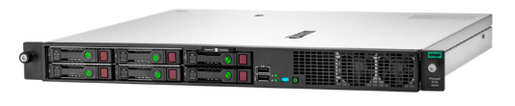
Test Topology
Configuration
Data Collection
Data Collection
Topology Config
Configuration
Data Collection
netperf, fio,
testgen,
To fill pipe
netperf, fio,
testgen
To fill pipe

Slide 2
Traffic Generation
Traffic Gen | Tooling | Measurements
Simultaneous netperf sessions | netperf bi-directional Throughput, pps, packet loss, Latency distribution Large frames, 64B frames w/ cfg | Single port throughput, pps, packet loss, latency distribution Max ports/interface throughput, pps, packet loss, latency distribution
Stateless traffic generation | packetgen bi-directional across different packet sizes / distributions Throughput, packet loss, Latency distribution | Single port throughput, pps, packet loss, latency distribution Max ports/interface throughput, pps, packet loss, latency distribution
fio | fio bi-directional Throughput, IOPS, latency distribution, transport re-transmit Different block sizes (default 4K) | Single disk throughput, IOPS, latency distribution, re-transmits Max disks/interface throughput, pps, latency distribution, re-transmits
Stateful Connection generation | Conngen bi-directional Throughput, connection/sec Latency distribution, transport re-transmit, Different payload sizes | Single port throughput, conn/sec, transport re-transmits, latency distro Max ports/interface throughput, conn/sec, transport re-transmits, latency distro

Slide 3
Test Suite
Test Case | Configuration | Expected Results
Back-to-back L2 | Bridging across server <->network | Wire-like performance card-to-card Packet integrity checks at the switch
Back-to-back L3 | Routing across server <-> network | Wire-like performance card-to-card Packet integrity checks at the switch
Back-to-back vSwitch | VXLAN, NAT, LB, security groups | Wire-like performance card-to-card (adjusted for header adds) Packet integrity checks at the switch
Back-to-back NVMe-o-TCP | Uni-directional Initiator-Switch-Target | Wire-like performance card-to-card Packet integrity checks at the switch
Back-to-back QoS | Rate Limit per device (BW, pps/IOPS) | Test rates below, above and just at config Packet integrity checks at the switch
Back-to-back IPsec | Single tunnel card-to-card Max tunnels card-to-card Max new tunnels/sec card-to-card | Wire-like performance card-to-card (adjusted for header adds) Packet integrity checks at the switch
Back-to-back Secure NVMe-o-TCP | Uni-directional Initiator-Switch-Target Encrypted Writes, De-crypted Reads | Wire-like performance card-to-card Packet integrity checks at the switch
Back-to-back TLS | Single connections card-to-card Max connections card-to-card Max new connections/sec card-to-card | Wire-like performance card-to-card (adjusted for header adds) Packet integrity checks at the switch
Back-to-back NVMe-o-TLS | Single connections card-to-card Max connections card-to-card Max new connections/sec card-to-card | Wire-like performance card-to-card (adjusted for header adds) Packet integrity checks at the switch

Slide 4
Host Interfacing
Host Interface Type | Tooling | Types
Bare Metal Host | PF, Hotplug, SR-IOV Port Speeds | Virtio-net, Virtio-blk, NVMe Device Specific LAN devices
Virtualized Guest | Emulated Device, Hotplug, SR-IOV Port Speeds | Virtio-net, Virtio-blk, NVMe Device Specific VF devices
Container Interface | Kernel veth, ipvlan, SR-IOV | Kernel netdev Device Specific VF devices
TLS Connection

